Slide 1
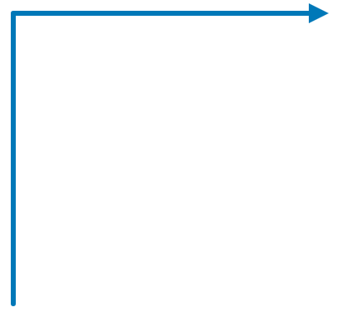






BYOT - Client owned transform logic, hosted and run by xyz
XYZ · PLUGIN FRAMEWORK
Standard API path
Request: filters, aggregation keys, attributes, plus an optional plugin name.
Typed Protobuf requests: filters, aggregation keys, attributes. SQL-style logic only.
no plugin
Query engine
Spark SQL from filters and aggregation keys
Plugin framework
Spark on HDFS
request
ADF xyz
Plugin host
Multi-step logic beyond SQL: custom transforms, mapping, joins with other datasets. Clients ship a JAR; xyz hosts it.
Client
plugin
Finds client JAR by name, calls transform()
Protobuf call
Routes by plugin name
Spark context runs both paths over distributed data
result
transform()
Standard query path
Client JAR
The contract
Implements transform() on a Spark DataFrame
Same API call plus a plugin name. xyz loads the JAR, calls transform on a Spark DataFrame, returns the result.
Plugin path
Response to client
Notes:
ADF exposes a typed Protobuf API for filters, aggregation keys and attributes. For logic SQL cannot express, clients provide a JAR that implements the transform method of ADF's plugin interface. The request names the plugin; ADF loads that JAR, runs transform on a Spark DataFrame using its Spark context, and returns the prepared data to the client.

Slide 2






Containers and relationships of the plugin framework
C4 MODEL · LEVEL 2 · CONTAINERS
Plugin contract
Data consumer
Query engine
transform(DataFrame)
request
xyz API
query
[Spark SQL]
xyz
[Protobuf API]
Interface defined by xyz, implemented by the client. Runs on xyz's Spark context.
Routes by plugin name
Filters, aggregation, attributes
plugin
Plugin framework
Spark runtime
Federated model
[Java, Spark]
runs on
[Spark context]
reads
HDFS
Runs query and plugin logic
S3
Clients own the logic. xyz hosts the JAR and owns the API, runtime and data access.
Calls client transform()
loads
Plugin developer
Client plugin JARs
builds
[Hosted JAR files]
Opt-in per request
xyz Tenants
Client-built transform logic
A plugin name in the request selects the JAR. No name means the standard query path.
Notes:
C4 container view. The consumer calls the typed Protobuf API. Without a plugin name the request goes to the query engine; with one, the plugin framework loads the client-provided JAR and invokes transform. Both paths run on the Spark runtime over HDFS. Plugin developers build the JARs that ADF hosts.

